Slide 1
Automated Feature Detection of Aerial Imagery from the South Pacific
Christian Taruc, Michael Chiang, Patrick Vidican, Zhenhui Jiang

Slide 2
Introduction

Slide 3
Research Question
The World Bank wants to find a way to quantify important resources in third world countries in case of emergencies.
“Being able to quantify the number of trees that serve as an important source of livelihood for local communities is essential. These trees and their locations can then be compared before and after major disasters to better understand just how much local agriculture and hence food security has been affected. This can directly inform and accelerate subsequent relief efforts. The focus on roads is also meant to help identify the impact of natural disasters on local transportation infrastructure and to inform how best to distribute aid across affected areas.”
-World Bank

Slide 4
Our goal is to be able to identify, count, and classify trees (coconut, banana, papaya or mango) for any given aerial image.

Slide 5
Data

Slide 6
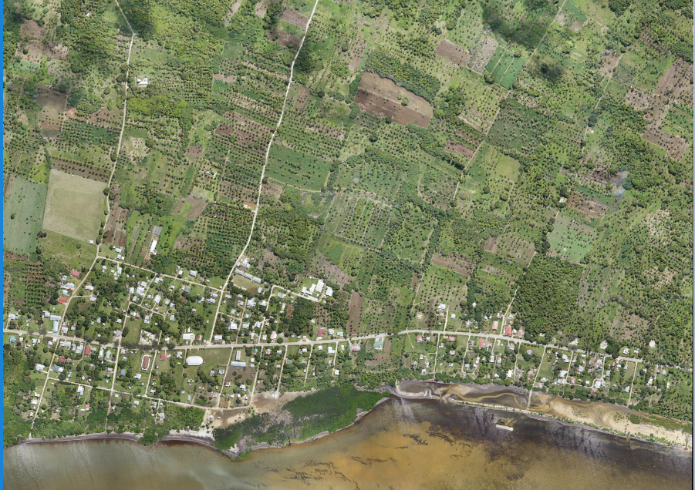
The Data
The imagery, courtesy of World Bank UAVs, were collected in October and comprise of four Areas of Interest (AOIs) in the country of Tonga. The spatial resolution of the optical imagery is 8cm. In general, the AOIs cover a combination of rural and urban areas. We use one stitched AOI (in this case covering the Kolovai village and surrounding regions).
Training data for relevant features of interest have been developed by the Humanitarian OpenStreetMap community, in the form of shapefiles.
80km² of high resolution (8 cm) aerial imagery

Slide 7
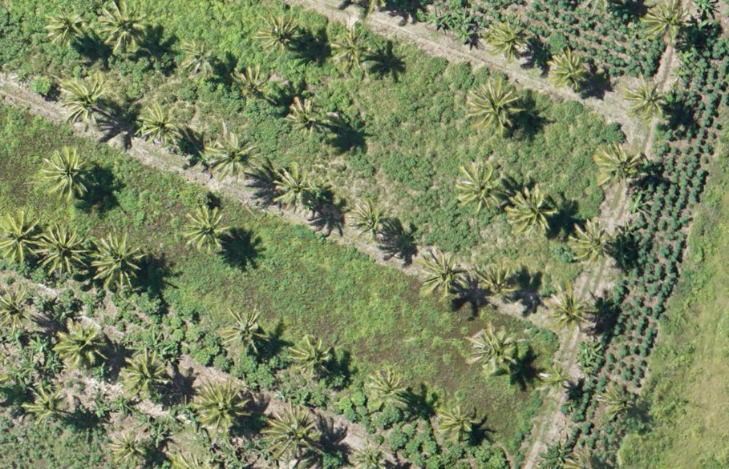
Magnified 8x
This is a very high resolution photo.

Slide 8
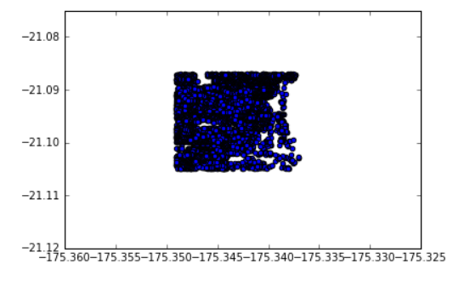
Feature Extraction
with PyQGIS and ArcMap
Using GIS software (ArcMap & PyQGIS) and shapefiles we are able to find the location of each coconut tree.
We used several methods of visualizing these coordinates.
The first attempt at visualization (using matplotlib)

Slide 9
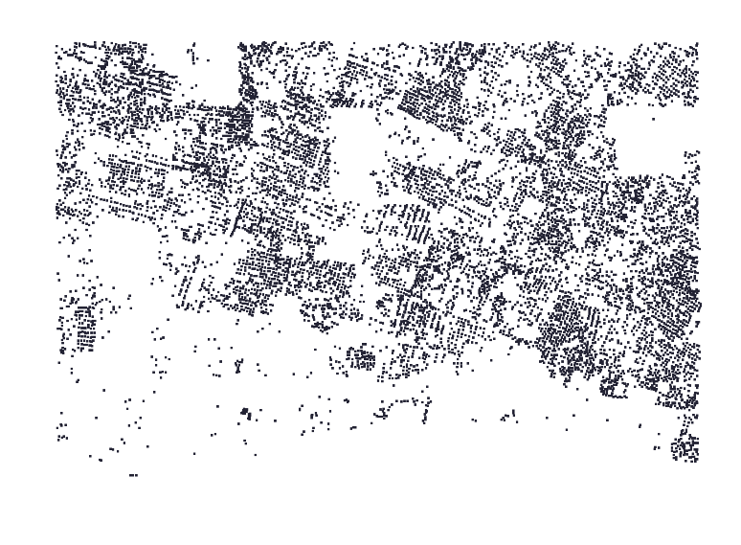
Plotting using ArcMap

Slide 10
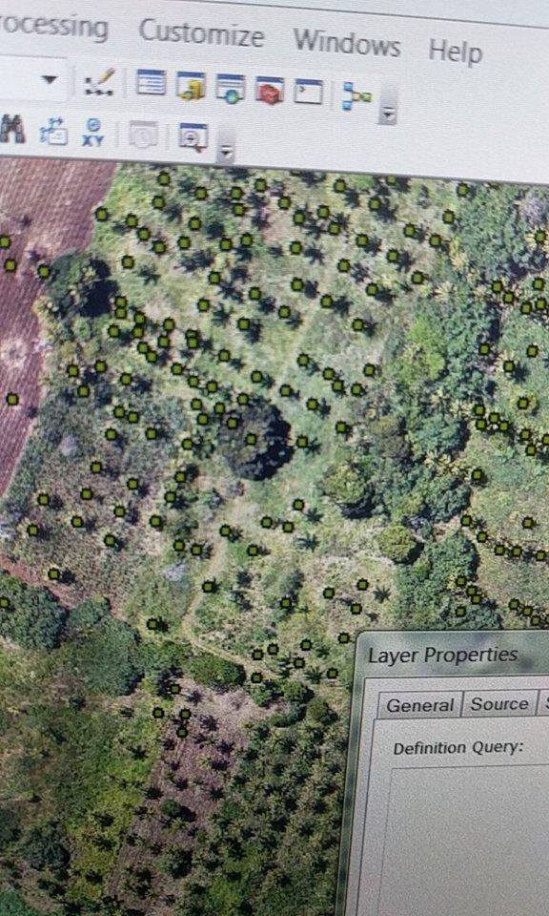
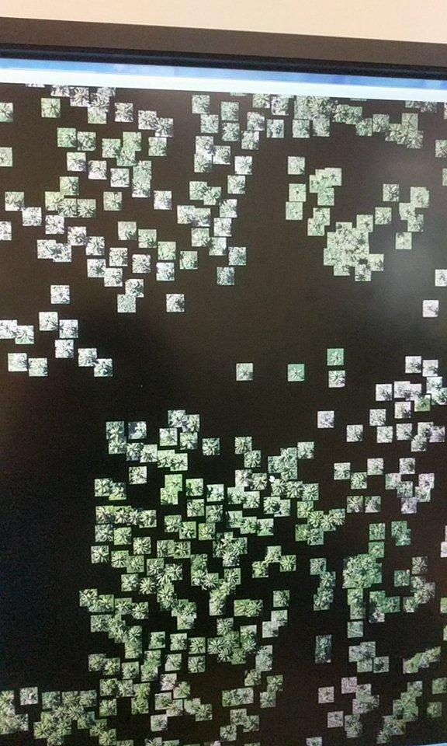
Feature Extraction & Preprocessing
In total we have 6,097 data points. For validation purposes we do an 80/20 split of the data.

Slide 11
Modeling

Slide 12
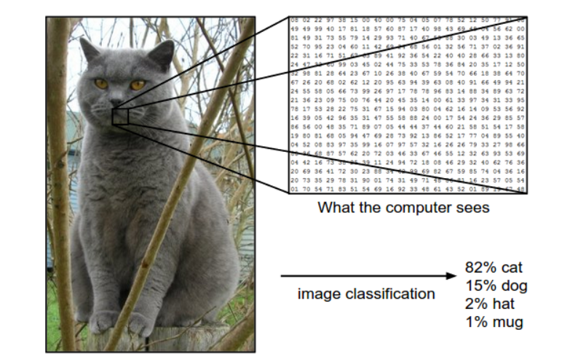
Introduction to Image Detection
It is possible to convert any given image into a multidimensional array.
These arrays contain information regarding the RGB value at each point of the image.
These arrays can then be fed into a supervised model for classification, recognition, etc.
Notes:
multidimensional array <- tensor in tensorflow
good overview done by first group
101,100,3

Slide 13
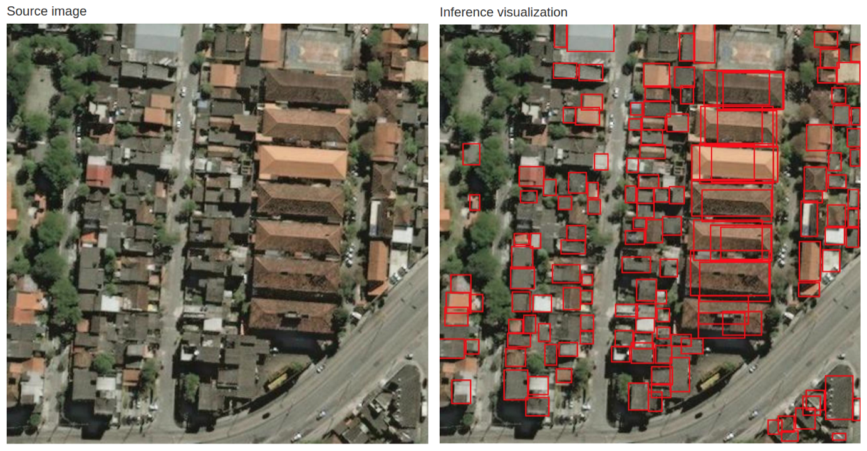
Object Recognition
Our original goal was to quantify the number and location of each tree type. There are a few tools to do this. (Fast R-CNN, YOLO).
At the end, we would have liked to bound each tree in a box which would be later used in our classification step.

Slide 14
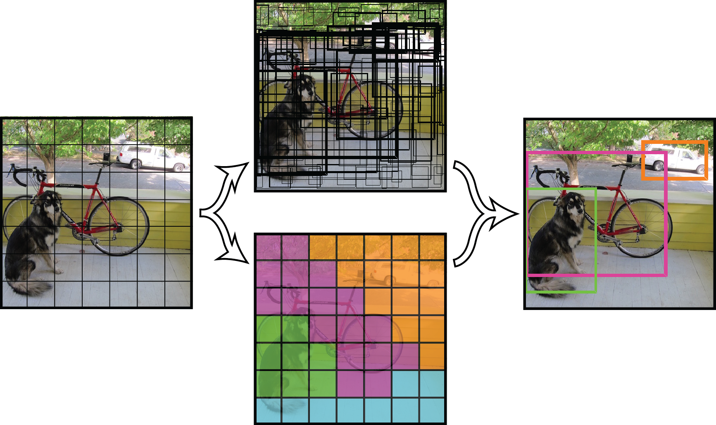
YOLO (You Only Look Once)
YOLO applies a single neural network to the entire image. This network divides the image into regions and predicts bounding boxes and probabilities for each region. These bounding boxes are weighted by the predicted probabilities.
Notes:
Object Detection can be modeled as a classification problem where we take windows of fixed sizes from input image, then put as ‘object proposoal’ at all the possible locations feed these patches to an image classifier.
yolo useful during emergency time since very fast and also does all at once so this contextual information helps in avoiding false positives.

Slide 15
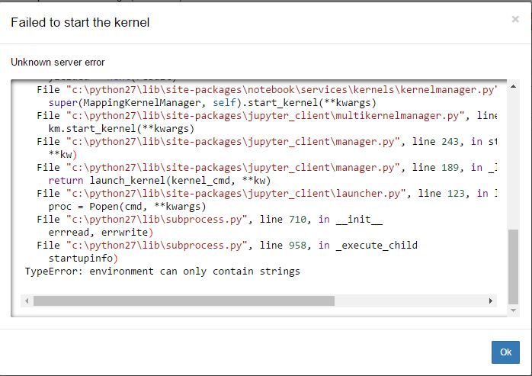
Object Recognition Challenges
However, these methods are relatively new and many are not implemented for the Python or Spark environment.
We were unable to get a functional object recognition model at the time of this presentation, but will continue to work on implementation.
Notes:
darknet, c++ library, very little python support (darkfl

Slide 16
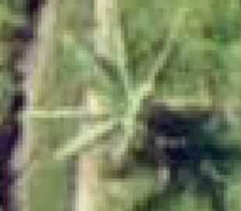
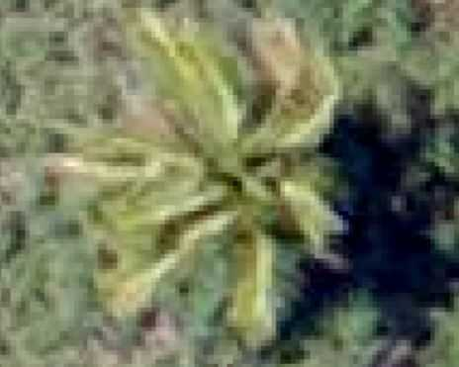
Image Classification
Can we tell the difference?
Can a machine?
Notes:
yo which one is which.

Slide 17
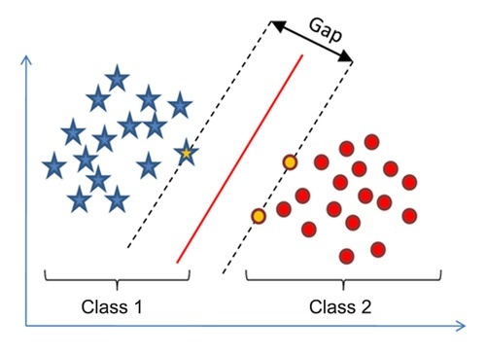
Linear SVM
Find the maximum-margin hyperplane that divides the group of points Class 1 and Class 2.
The star and the circles shaded in yellow represent the Support Vector.
Goal is to use this gap to properly classify the data into Class 1 or Class 2.
Notes:
talk about how this would be useful for image classification (i.e. within the pixel gap there is a useful feature etc.)

Slide 18
Convolutional Neural Networks
Convolutional Layer, Pooling Layer, and Fully-Connected Layer
CONV layer will compute the output of neurons that are connected to local regions in the input, each computing a dot product between their weights and a small region they are connected to in the input volume. (finds the most important features).
POOL layer will perform a downsampling operation along the spatial dimensions.
FC (i.e. fully-connected) layer will compute the class scores, giving a final score.
Notes:
Instead of having fixed numbers in our kernel, we assign parameters to these kernels which will be trained on the data. As we train our convolutional net, the kernel will get better and better at filtering a given image (or a given feature map) for relevant information. This process is automatic and is called feature learning. Feature learning automatically generalizes to each new task: We just need to simply train our network to find new filters which are relevant for the new task.

Slide 19
More information on CNN’s
http://cs231n.github.io/
Stanford CS class CS231n: Convolutional Neural Networks for Visual Recognition.

Slide 20
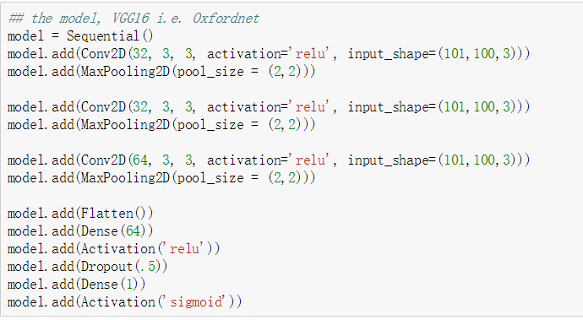
Our Neural Net
Notes:
RELU: ACTIVATION It computes the function f(x)=max(0,x) THRESHHOLD AT ZERO

Slide 21
Using Spark for Deep Learning
Elephas & Keras
“Elephas implements a class of data-parallel algorithms on top of Keras, using Spark's RDDs and data frames. Keras Models are initialized on the driver, then serialized and shipped to workers, alongside with data and broadcasted model parameters. Spark workers deserialize the model, train their chunk of data and send their gradients back to the driver. The "master" model on the driver is updated by an optimizer, which takes gradients either synchronously or asynchronously.”
Using this tool we have an implementation of Spark into Keras. We can then use Spark’s RDDs and dataframes for Keras models.

Slide 22
Conclusion and Challenges

Slide 23
What worked?
Found the location of each coconut tree in training picture
Pre-processed each training coconut tree
Down-sampled the coconut tree
Fitted a model to classify the coconut tree

Slide 24
Challenges
Data pre-processing(extracting trees, transforming to arrays) is really hard.
Too many features and pictures need to be trained(101*100*3*6000)
Spark version not updated (SVM, PCA)

Slide 25
What’s next?
Find a way to implement PCA to reduce features dimensions.
Fit one or two more models for the classification.
Fit a model to find the counts of coconut trees and other trees.

